Slide 1
Stock Price Prediction
Team 10
Chien-Chun Liao, Wei-Chien Cheng, Qiyang Liu, Jane Song, Long Wan

Slide 2
Agenda
01
02
04
05
03
Motivation
Gathered Data
Data Preprocessing
DCF Model VS Machine Learning
Source: Capital IQ, Yahoo Finance, Twitter news
Combination, Cleaning, Timestamp, NLP(news), Scaling
Regression Models
Results
- Time serious + PCA/non-PCA
with Regression models
- Model Tuning & Ensemble

Slide 3
"I like the idea of using artificial intelligence, because we're so short of the real thing."
—Charlie Munger Vice Chairman, Berkshire Hathaway

Slide 4
01
Motivation
DCF Model VS Machine Learning

Slide 5
Discounted Cash Flow Analysis
Risks
Assumptions
Issues
Dependencies
Weighted Average Cost of Capital
Exit Multiple
Challenging to estimate the WACC
Very sensitive to changes in assumptions
Terminal Value is hard to estimate
External factors cannot be incorporated into the model
Unable to reflect changes in stock prices in real time
Target Capital Structure
Levered Beta

Slide 6
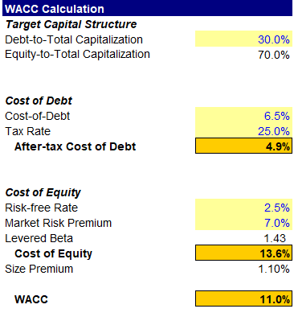
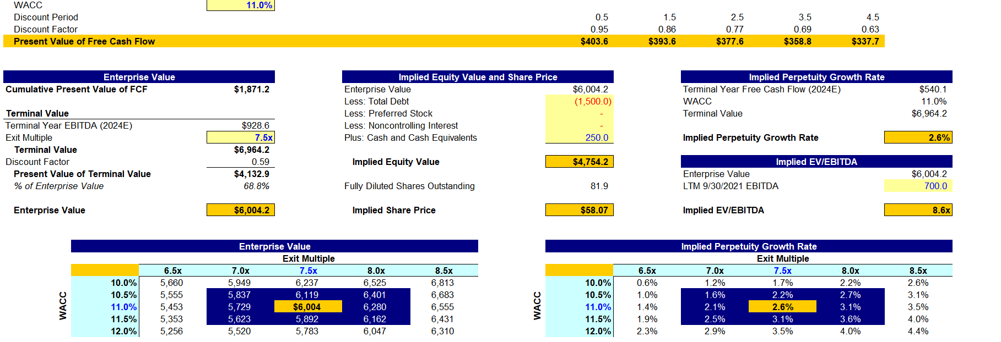

Slide 7
02
Gathered Data
Source: Capital IQ, Yahoo Finance, Twitter news

Slide 8

Targeted Companies
19 companies in Information Technology Industry
- Technology Hardware, Storage and Peripherals
Apple, HP, Seagate Technology Holdings, NetApp, Western Digital Corporation
- Software and service
Microsoft, Visa, MasterCard, Oracle, Accenture, Adobe, Salesforce
- Semiconductors
NVIDIA, Broadcom, Intel, Texas Instruments, Advanced Micro Devices, QUALCOMM, Analog Devices
Time Period: 2010.01.01 - 2019.12.31

Slide 9
Data Scource
Firm Financials - Capital IQ
Industry level – Fama French
Index – Capital IQ
Macroeconomics – Government Web
News – Twitter/ Capital IQ
Daily Stock Price – Yahoo Finance

Slide 10
Variables
Firm Financials
News
Industry Level
Fama French 12 Industry
General News(Source: Twitter – Wall Street Journal)
Firm Specific News(Capital IQ)
Index
Dow, Nasdaq, S&P
ROA, Investment to asset, Net stock issue, Book-to-Market Equity, TEV/Total Revenue, P/LTM EPS, P/NTM EPS, Market Cap/LTM Levered FCF, TEV/LTM Unlevered FCF, EBIT Margin, Profit Growth, Inventory Growth
Macroeconomics
WAAA
Industrial Production Index
Crude oil price
Consumer Price Index
Daily Stock Price
Close(Dependent Variable)

Slide 11
03
Data Preprocessing

Slide 12
03 Cleaning
Missing Value
1. Removing NaN daily stock price (Weekends and holidays) 2. Mathing quartely Variable (Firm Financials) 3. Matching monthly variables (Macroeconometics variables)

Slide 13
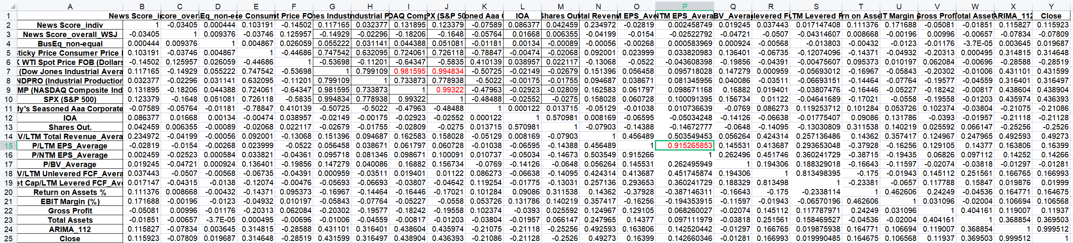
Cleaning
Correlation
COMP (NASDAQ Composite Index) &SPX (S&P 500) ：0.9932 COMP (NASDAQ Composite Index) & DJI (Dow Jones Industrial Average)：0.9815 DJI (Dow Jones Industrial Average) & SPX (S&P 500)：0.9948 P/LTM EPS_Average & P/NTM EPS_Average: 0.9152
Drop higher correlated Variables

Slide 14
Data Preprocessing
01
02
03
04
NLP
Cleaning
News
missing value, correlation, data distribution
Combination
Scaling
Combine tables from different resources with Timestamp

Slide 15
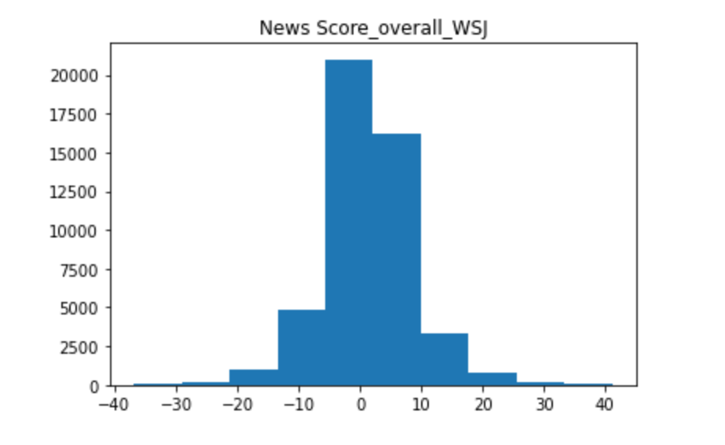
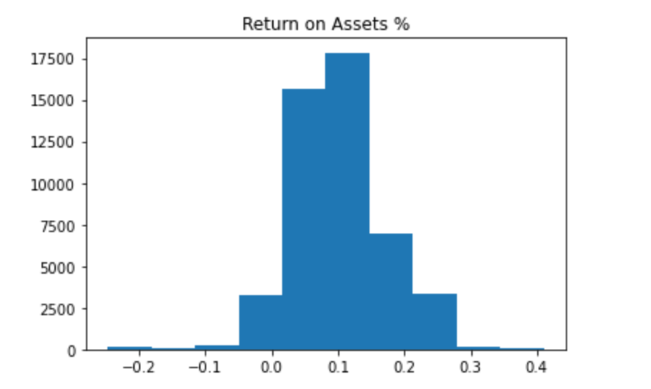
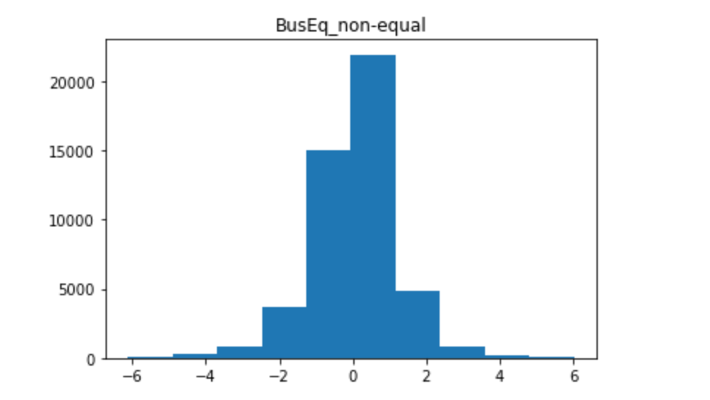
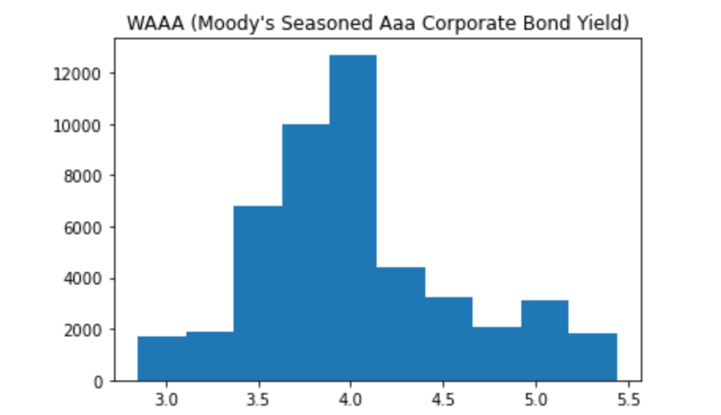
03 Cleaning......?
Distribution

Slide 16
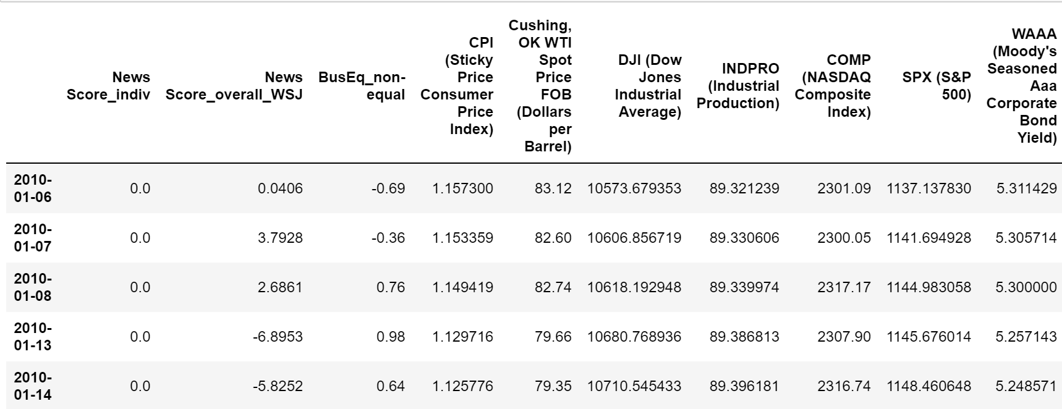
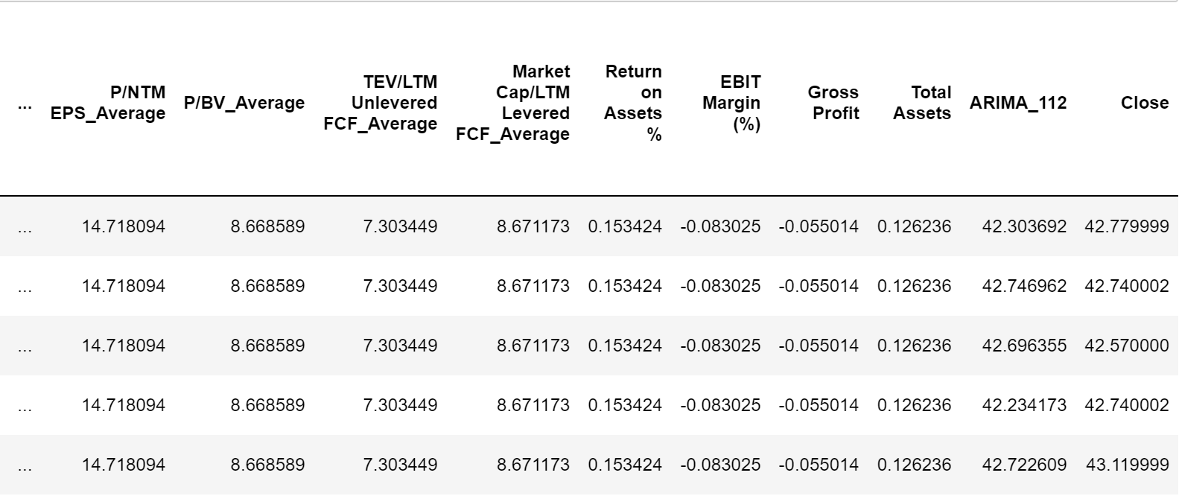
Prepared Dataset
Observations: 47747
Variables: 25

Slide 17
04
Regression Model
Model Turning
- Time Series
- Regression
Ensembling

Slide 18
Traing &Validation Dataset
Test Dataset
2010.01.01 - 2016.12.31
2017.01.01 - 2019.12.31

Slide 19
Step1 Time Series
Step2 Regression
Model Tuning
Stationary - MA/AR/ARMA/ETS
Non-Stationary - DETS/DMA/ARIMA
Hyperparamter Tuning (e.g. p,d,q)
Cross Validation
Get top 3 models generate 'predict P'
PCA/ Non-PCA
LR, LASSO, REIDGE, SVR, KNN, GradientBoost, Ramdom Forest
GridSearchCV

Slide 20


Time Series Analysis
 | Parameters | Score(MSE)
Stationary: | MA(1) | 0.7453
 | AR(1) | 0.7500
 | ARMA(1,1) | 0.7499
 | ETS | 0.7590
Non-Stationary: | DETS | 0.7462
 | DMA(2) | 1.2225
 | ARIMA(1,1,2) | 0.7462
Dataset 1
Dataset 2
Dataset 3

Slide 21
42 models
Regression
Time Series
LR LASSO REIDGE SVR KNN GradientBoost Ramdom Forest
PCA/ Non PCA
MA(1) DETS ARIMA(1,1,2)
3 × 2 × 7

Slide 22
05
Results

Slide 23
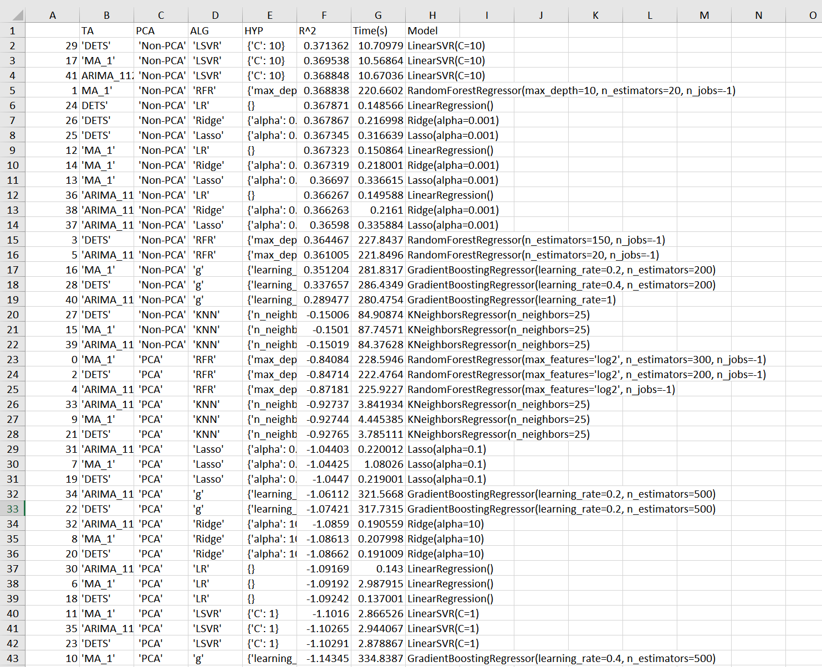

Slide 24
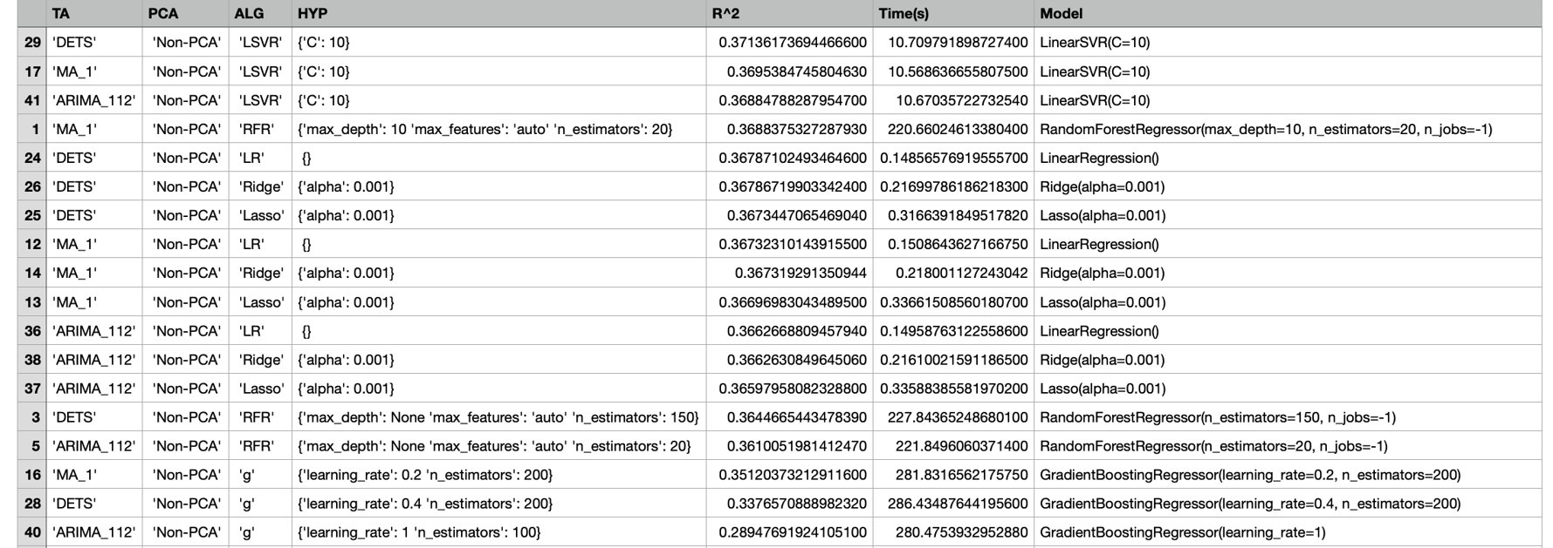

Slide 25
Averaging Ensembling Models
Time Series | Regression | R^2: | Time
DETS | Non-PCA LinearSVR('C': 10 | 0.37136 | 10.709791
MA_1 | Non-PCA LinearSVR ('C': 10) | 0.36953 | 10.56863
ARIMA_112 | Non-PCA LinearSVR('C': 10) | 0.36884 | 10.67035
MA_1 | Non-PCA RandomForest{'max depth': 10 ' | 0.36883 | 220.66024
DETS | Non-PCA LR | 0.36787 | 0.14856
After Emsemble R^2: 0.3678

Slide 26
Thank you!

